Slide 1

THIRD EYE FOR THE BLIND
Team Number: 8
School Of Engineering
Computer Science and Engineering
Team Members:
Guided by :
Mr. Narasimha Reddy
1. E. Akshay 2011CS010085 2. B. Sai Sankeerth 2011CS010049 3. Siddhanth Bang 2011CS010089 4. E. Sumanth Reddy 2011CS010088

Slide 2
ABSTRACT
The Third Eye and Ultra Sonic Glove represent groundbreaking wearable technologies catering to the visually impaired. Leveraging ultrasonic waves, these devices serve as discreet, efficient obstacle detection systems. Customizable vibrations or buzzer sounds alert users to nearby impediments, fostering enhanced mobility and independence. Whether worn as a band or seamlessly integrated into clothing, these solutions provide cost-effective alternatives to traditional aids, such as white canes. Aimed at addressing the daily challenges faced by the estimated 39 million blind individuals globally, these projects embody a commitment to creating abstract, versatile, and user-friendly solutions for improved navigation without extensive training..

Slide 3
INTRODUCTION
The project aims to develop a wearable device tailored for blind individuals, employing ultrasonic sensor technology for obstacle detection. The primary objective is to provide alerts through a combination of buzzer sounds and vibrations, enhancing the safety and independence of visually impaired users as they navigate their surroundings.
The device, designed with user comfort in mind, strives to contribute to improved accessibility and ease of daily life for individuals with visual impairments.
The third eye for blind is to create a product that will be extremely valuable to persons who are vison impaired and frequently depend on others.
The Third Eye for Blind project is a development that allows externally disabled people to move around and go from one place to another with confidence and speed by notifying them to nearby obstacles using a wearable band that emits ultrasonic waves that they are alerted to with a buzz sound or vibrations According to the definition of blindness, we are referring to a person who is unable to see.

Slide 4
Main objectives
Design a wearable device for blind people.
Alerting the blind person in the form of buzzer.
Ultrasonic sensor based obstacle detection.

Slide 5
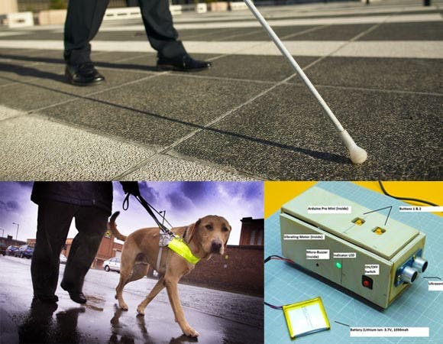
EXISTING SYSTEM AND LIMITATIONS
White Cane:
May easily crack or break, posing a durability issue.
The stick may get stuck at pavement cracks or different objects, limiting smooth navigation.
Pet Dog:
Involves a substantial cost, with an approximate price of $42,000 or 280,000 Rs.
Requires significant financial investment, making it inaccessible to many individuals.
Smart Devices (e.g., Vision Torch for the Blind):
Cannot be carried easily, hindering portability.
Requires a considerable amount of training to use effectively.

Slide 6
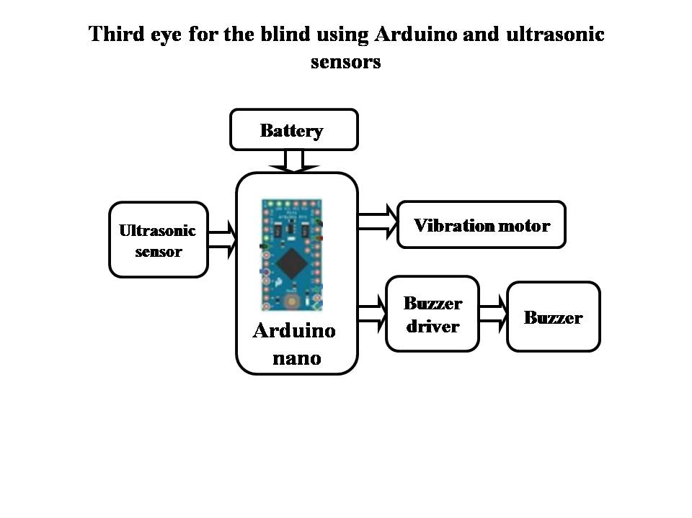
PROPOSED SYSTEM
The project “Third eye for the blind using Arduino and ultrasonic sensor” was designed a wearable device that is used to provide security and alerts the blind people with the help of ultrasonic sensor, buzzer and vibration.
Whenever ultrasonic sensor detects any obstacle, this will be fed as input to the micro controller and the microcontroller active the buzzer and vibration motor which is used to indicate the blind presence about obstacle nearer to it.

Slide 7
ADVANTAGES OF PROPOSED SYSTEM
Enhanced Navigation:
The device acts as a guiding tool for blind individuals, significantly improving their ability to navigate and move confidently in various environments.
Immediate and Clear Alerts:
Incorporates a dual-alert system, utilizing both a buzzer alarm and vibration, ensuring that users receive immediate and unmistakable notifications about nearby obstacles.
Cost-Effective Accessibility:
Features an efficient and low-cost design, making the technology economically accessible to a broader demographic of visually impaired individuals.
Energy-Efficient Operation:
Optimizes power consumption for prolonged battery life, reducing the need for frequent recharging and enhancing the device's overall reliability.
User-Friendly Design:
Designed with simplicity in mind, the device requires minimal training for users to operate effectively, promoting quick adoption and usability among visually impaired individuals.

Slide 8
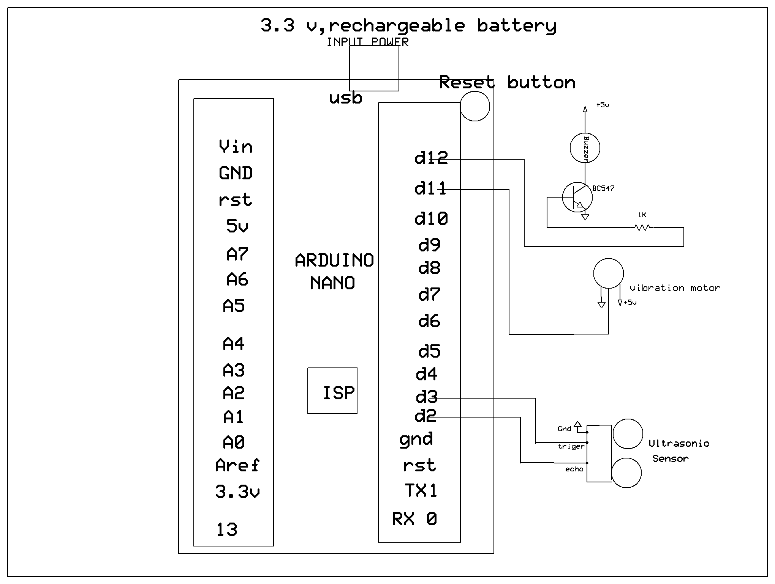
CIRCUIT DIAGRAM

Slide 9
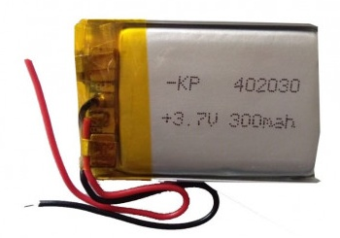
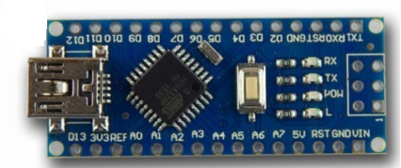
TOOLS USED
3.3v battery : 3.7V 300mAH (Lithium Polymer) Lipo Rechargeable Battery to provide the power supply of the device.
Arduino nano: Arduino Nano is based on the ATmega328 SMD chip. It has 14 digital input/output pins (of which 6 can be used as PWM outputs), 8 analog inputs, 1 UARTs (hardware serial ports), a 16 MHz crystal oscillator, a USB connection, and a reset button.

Slide 10
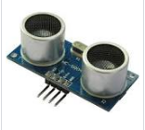
Ultrasonic sensor : ultrasonic sensor is an instrument that measures the distance to an object using ultrasonic sound waves. An ultrasonic sensor uses a transducer to send and receive ultrasonic pulses that relay back information about an object's proximity.
Vibration motor : A vibration motor is a compact, coreless DC motor that generates mechanical vibrations by supplying energy.

Slide 11
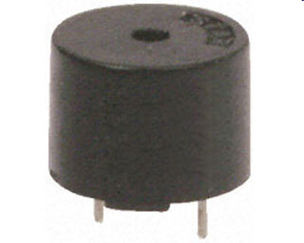
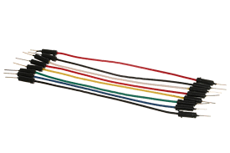
Buzzer : A buzzer is a device that converts audio signals into sound. Buzzers are also known as beepers. They can be mechanical, electromechanical, or piezoelectric.
Jumper wires : Jumper wires are electrical wires with connector pins at each end.

Slide 12
Future Scope
We can add GSM module to send the alert voice message.
We can add GPS module to track the location of the blind person.

Slide 13
THANK YOU

